Slide 1
McStas Union components
Mads Bertelsen, ESS DMSC

Slide 2
Union in instrument file
Only the Union_master component affect the rays
3D space of simulation
Instrument component sequence

Slide 3
Union in instrument file
Only the Union_master component affect the rays
In the Union_master there is propagation in a network instead of sequential
3D space of simulation
Instrument component sequence

Slide 4
Union in instrument file
Only the Union_master component affect the rays
In the Union_master there is propagation in a network instead of sequential
The network complexity is reduced by geometrical analysis before raytracing
3D space of simulation
Instrument component sequence

Slide 5

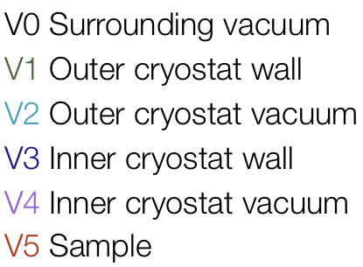




Union ray histories
Top 5 most common histories. Shows the index of volumes entered (VX), and the processes (PX)
313073 N I=5.09E+02 V0 -> V1 -> V2 -> V3 -> V4 -> V5 -> V4 -> V3 -> V2 -> V1 -> V0
24844 N I=3.57E+01 V0 -> V1 -> V2 -> V3 -> V4 -> V5 -> P1 -> V4 -> V3 -> V2 -> V1 -> V0
13679 N I=2.22E+01 V0 -> V1 -> V2 -> V3 -> V4 -> V3 -> V2 -> V1 -> V0
9510 N I=1.85E+01 V0 -> V1 -> V2 -> V3 -> V4 -> V6 -> V4 -> V3 -> V2 -> V1 -> V0
159655 N I=1.41E+01 V0 -> V1 -> P1 -> V0
P1 Is scattering process 1

Slide 6
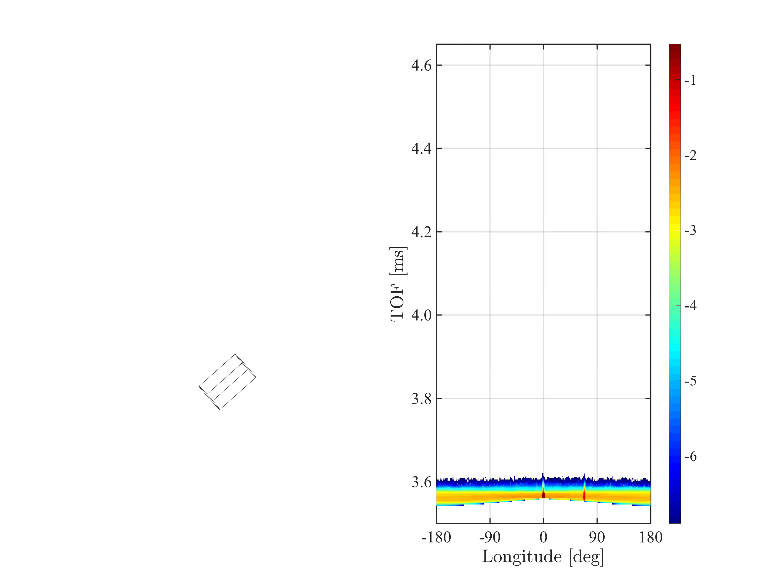
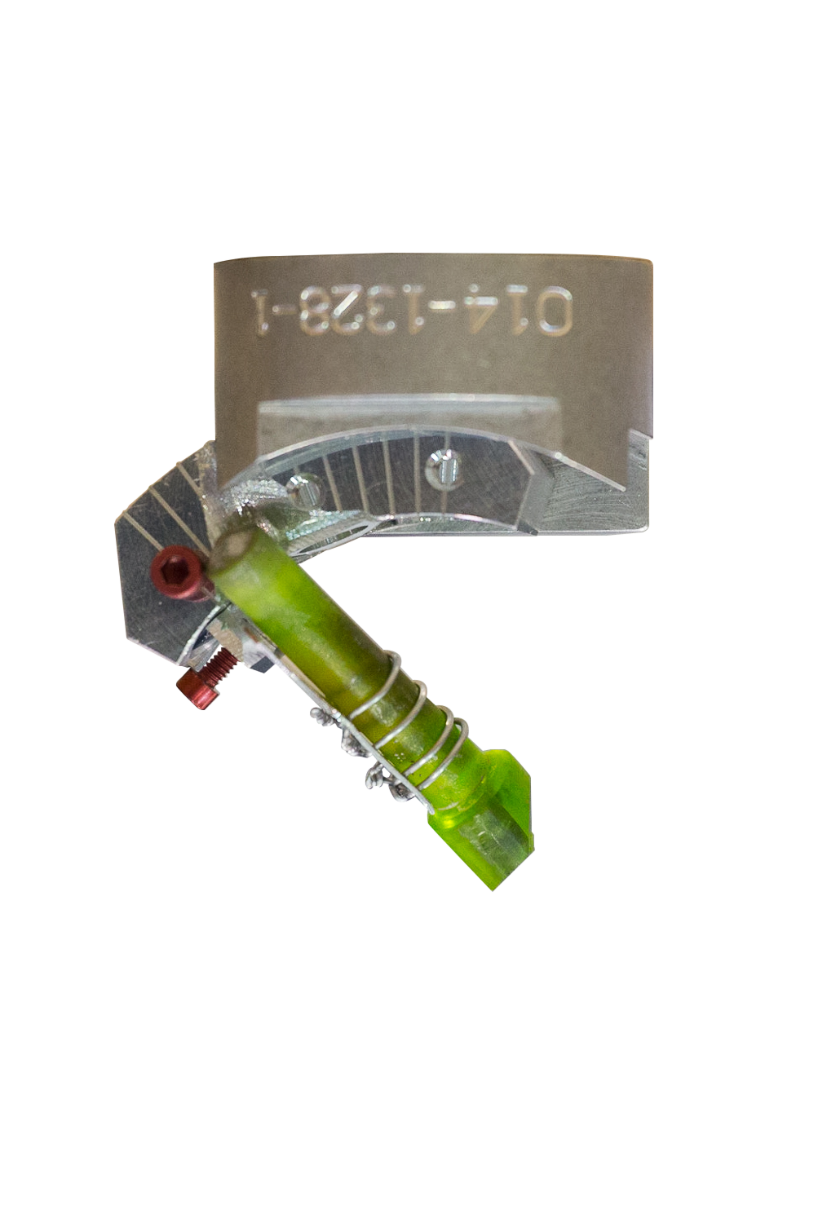
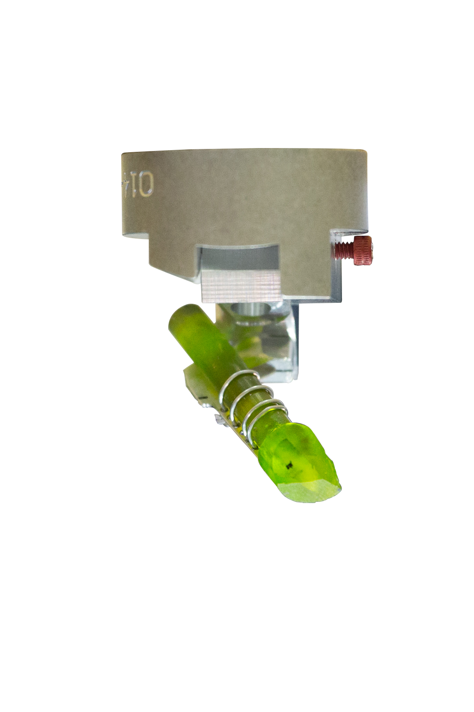
Building a sample
log(I)
5 meV beam

Slide 7
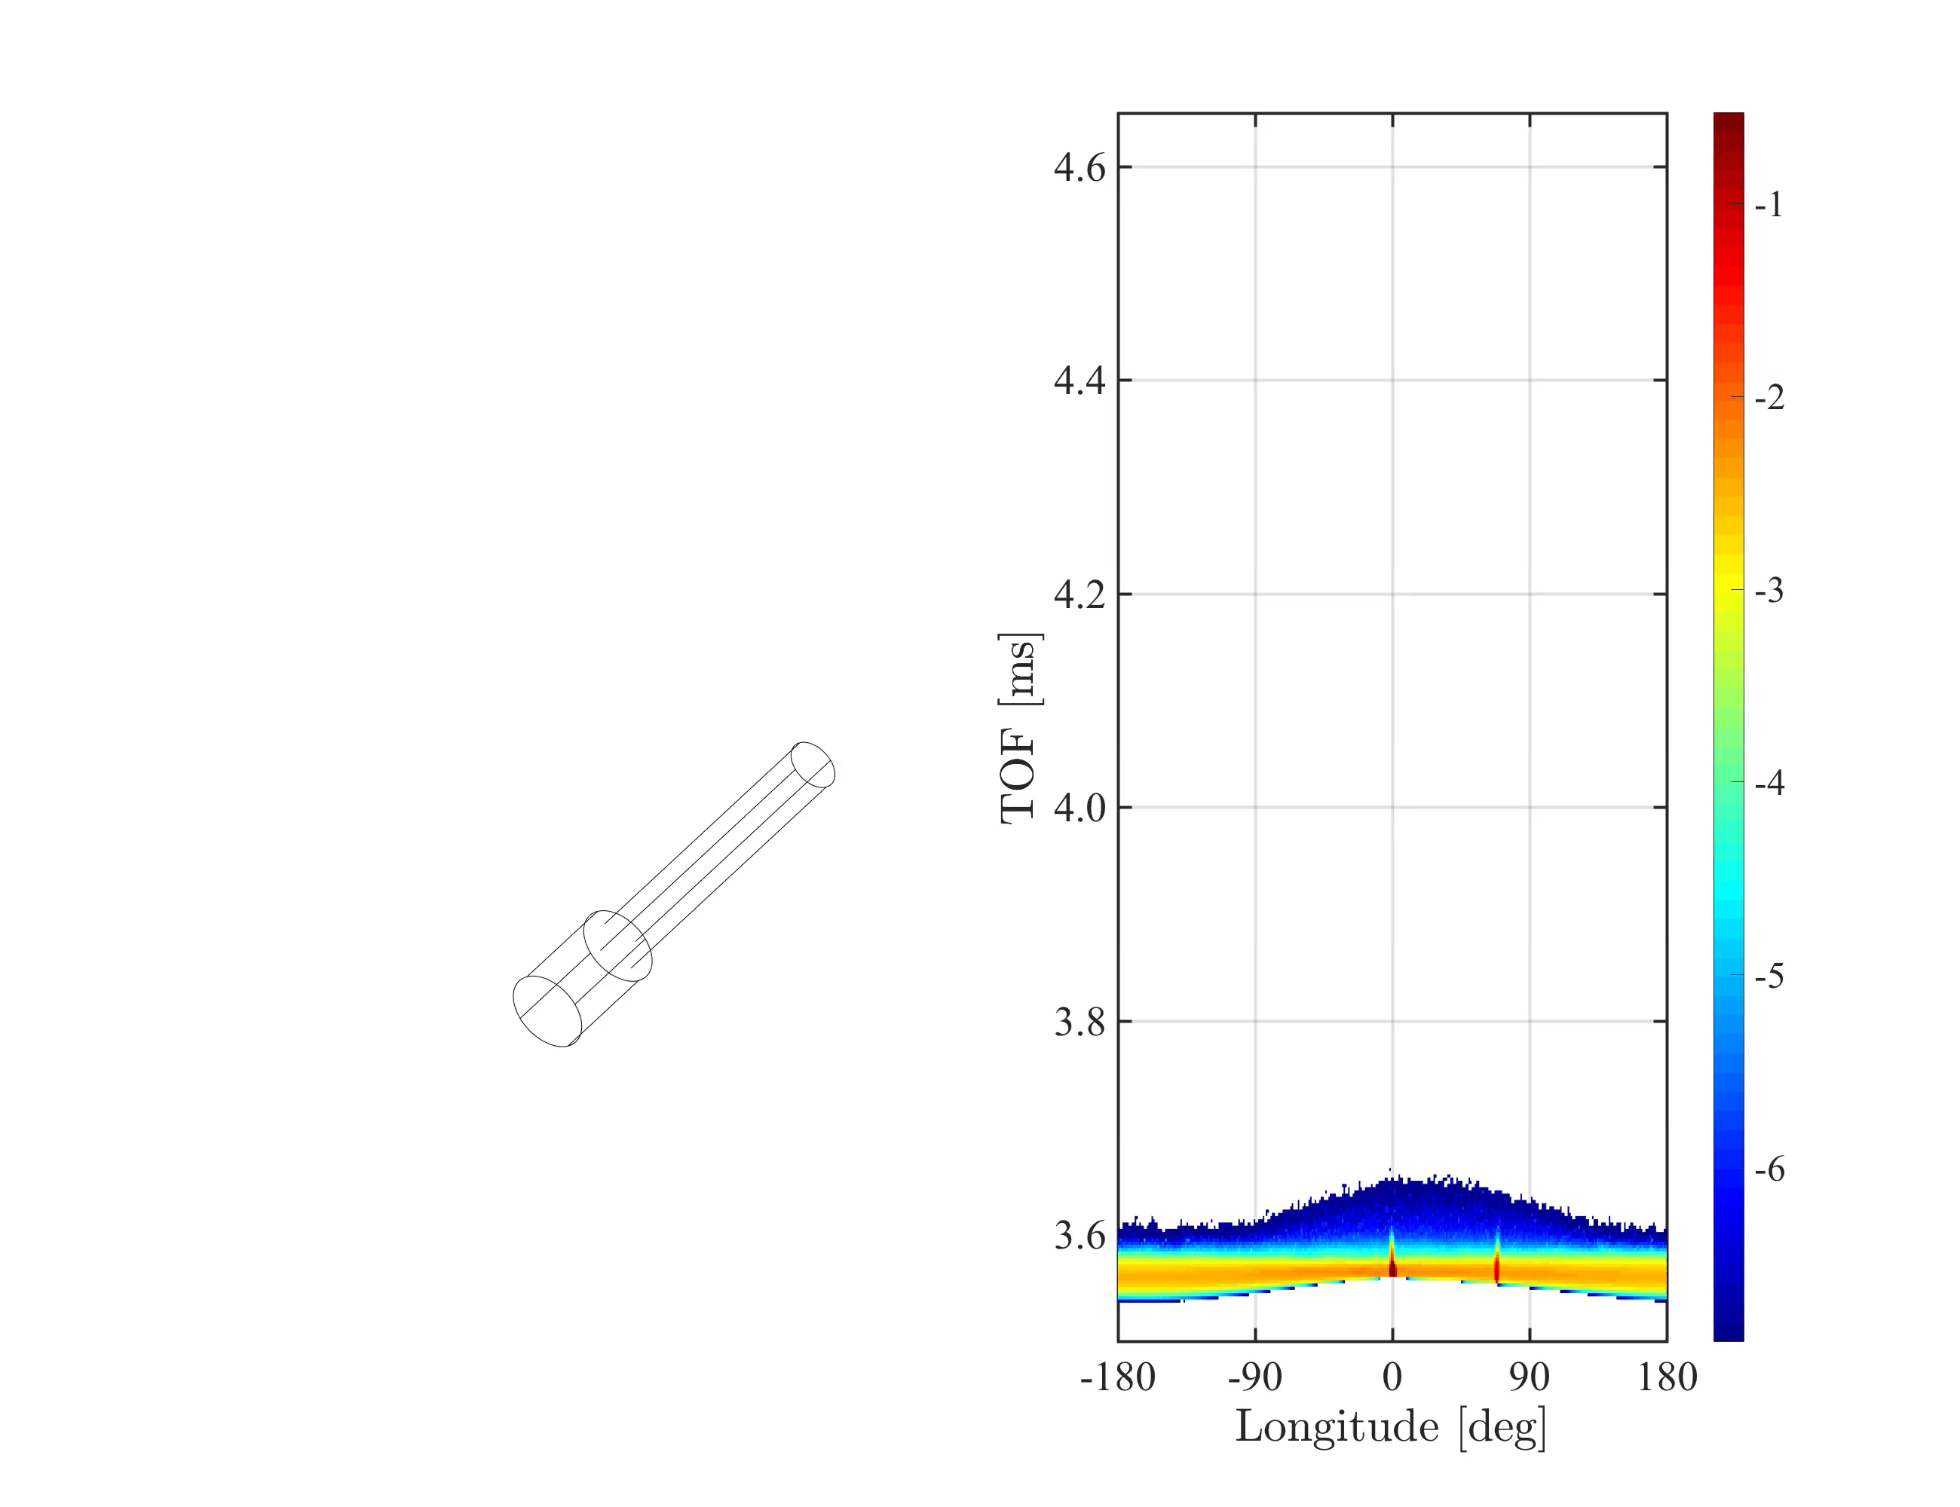
Building a sample
log(I)

Slide 8
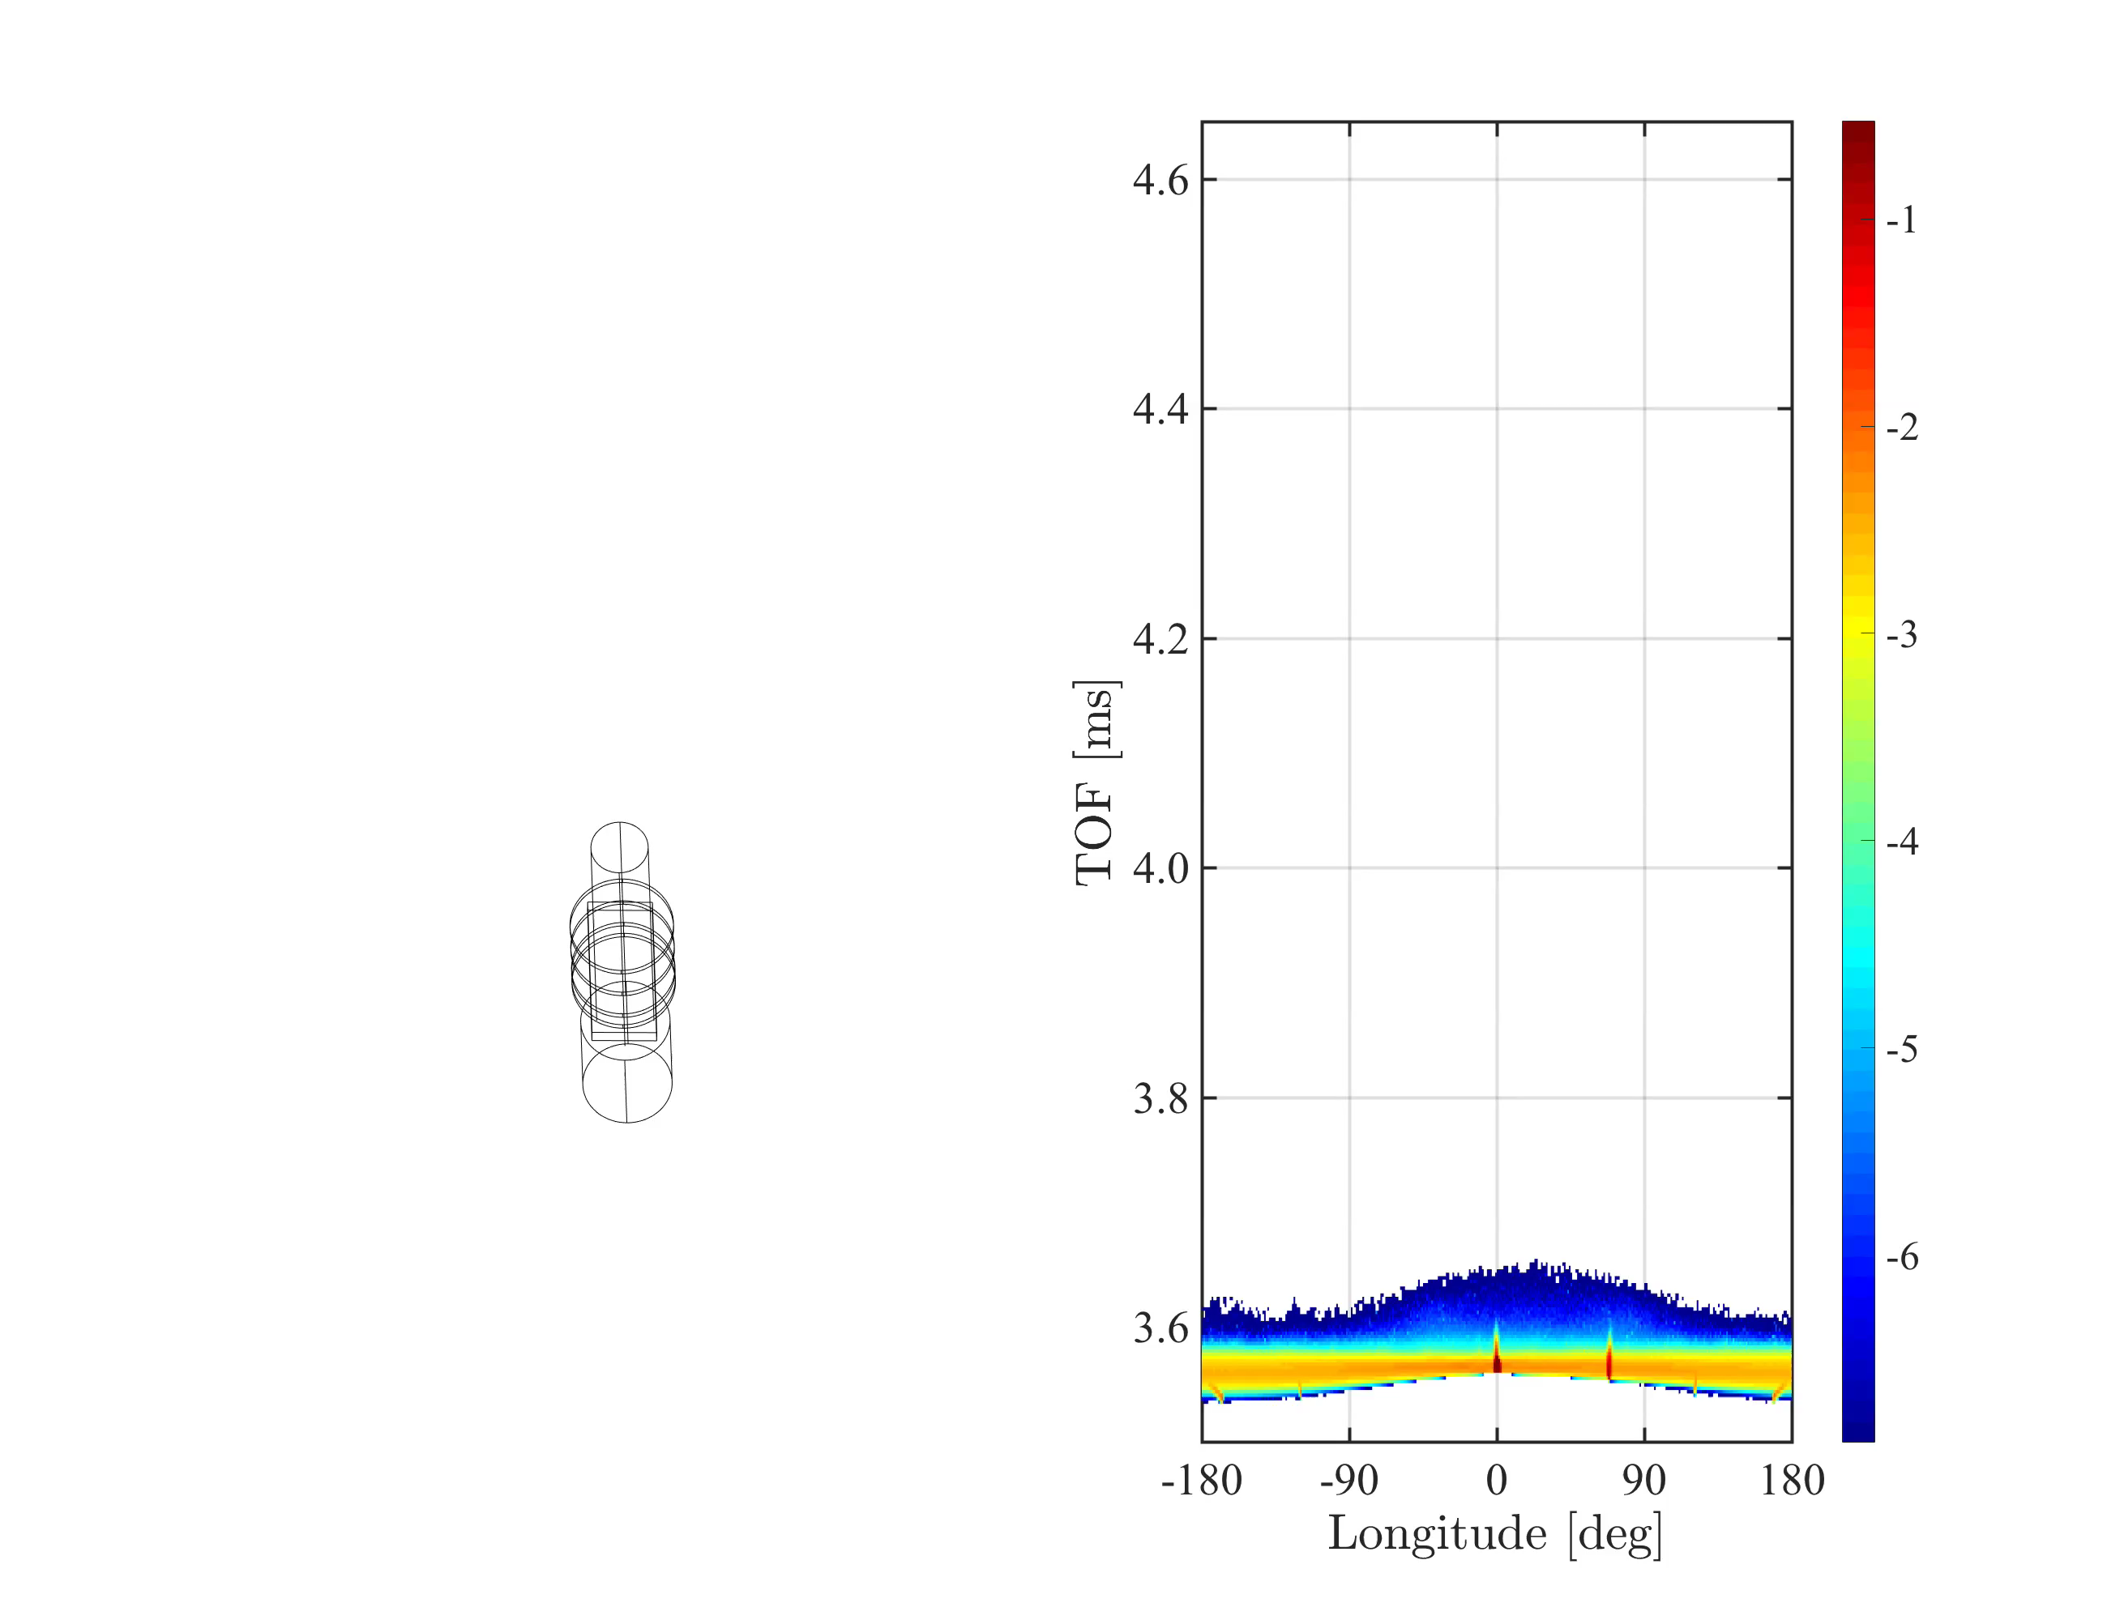
Building a sample
log(I)

Slide 9

Building a sample
log(I)

Slide 10
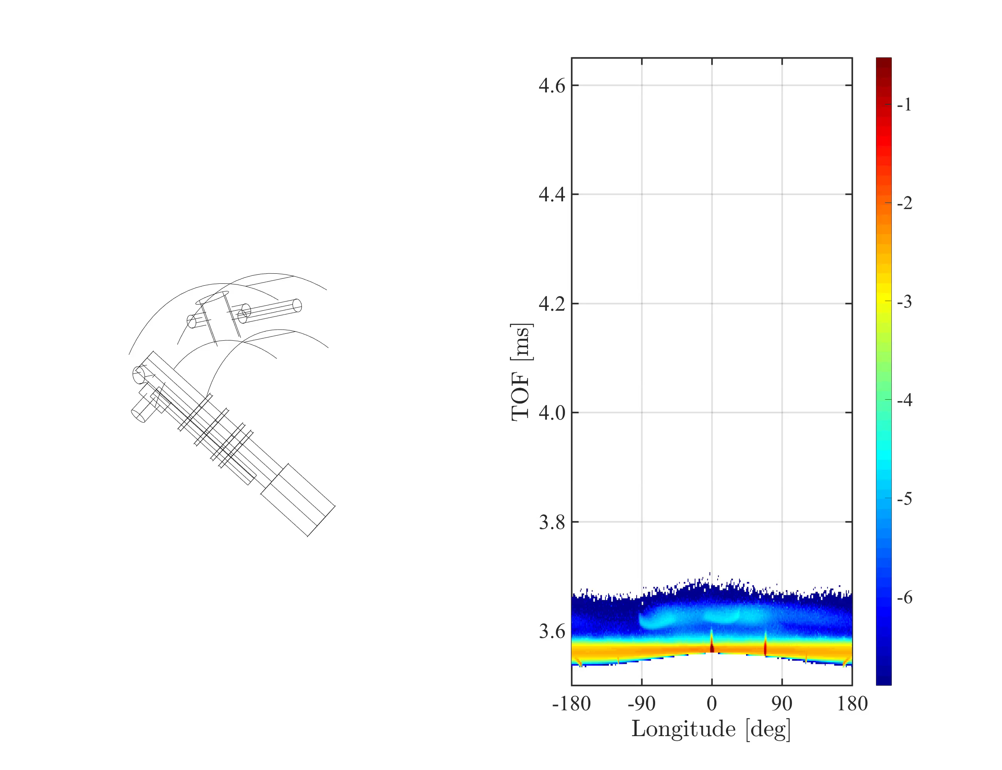
Building a sample
log(I)

Slide 11
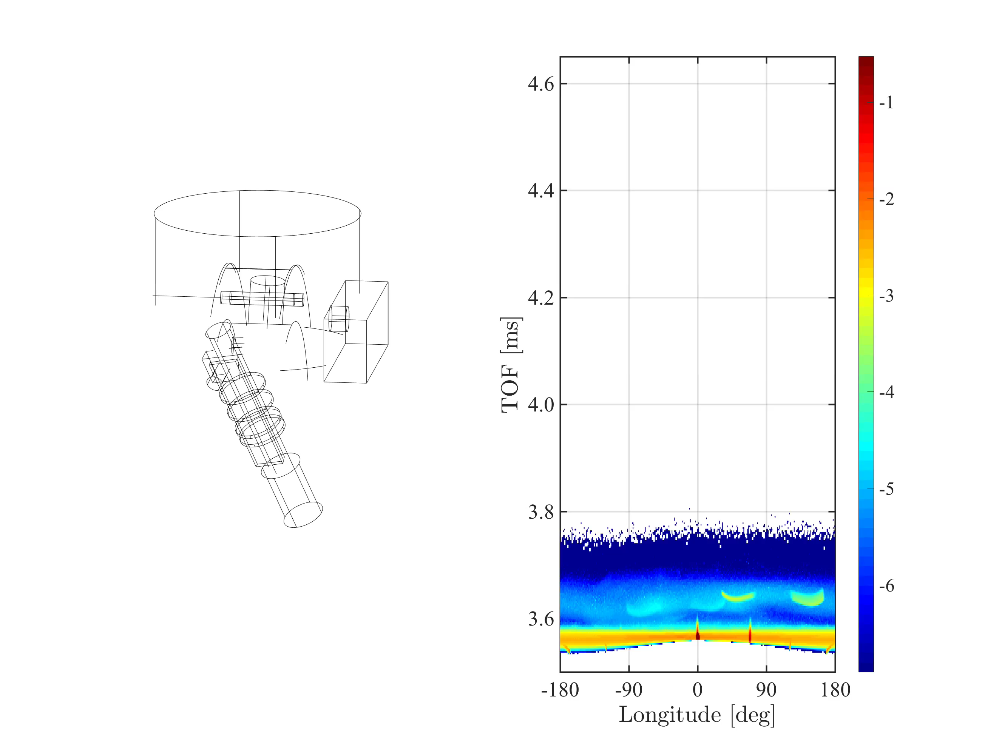
Building a sample
log(I)

Slide 12
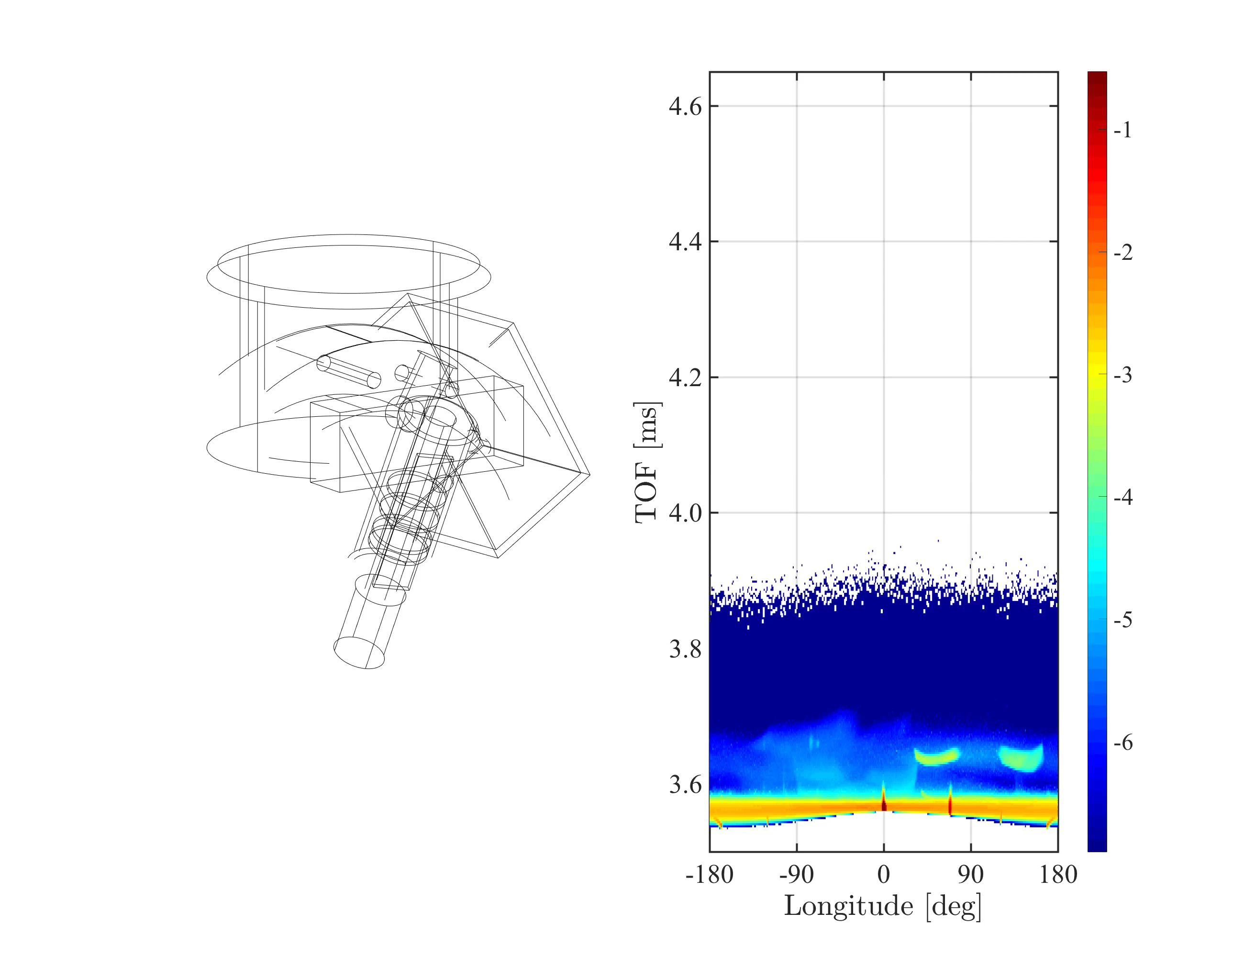
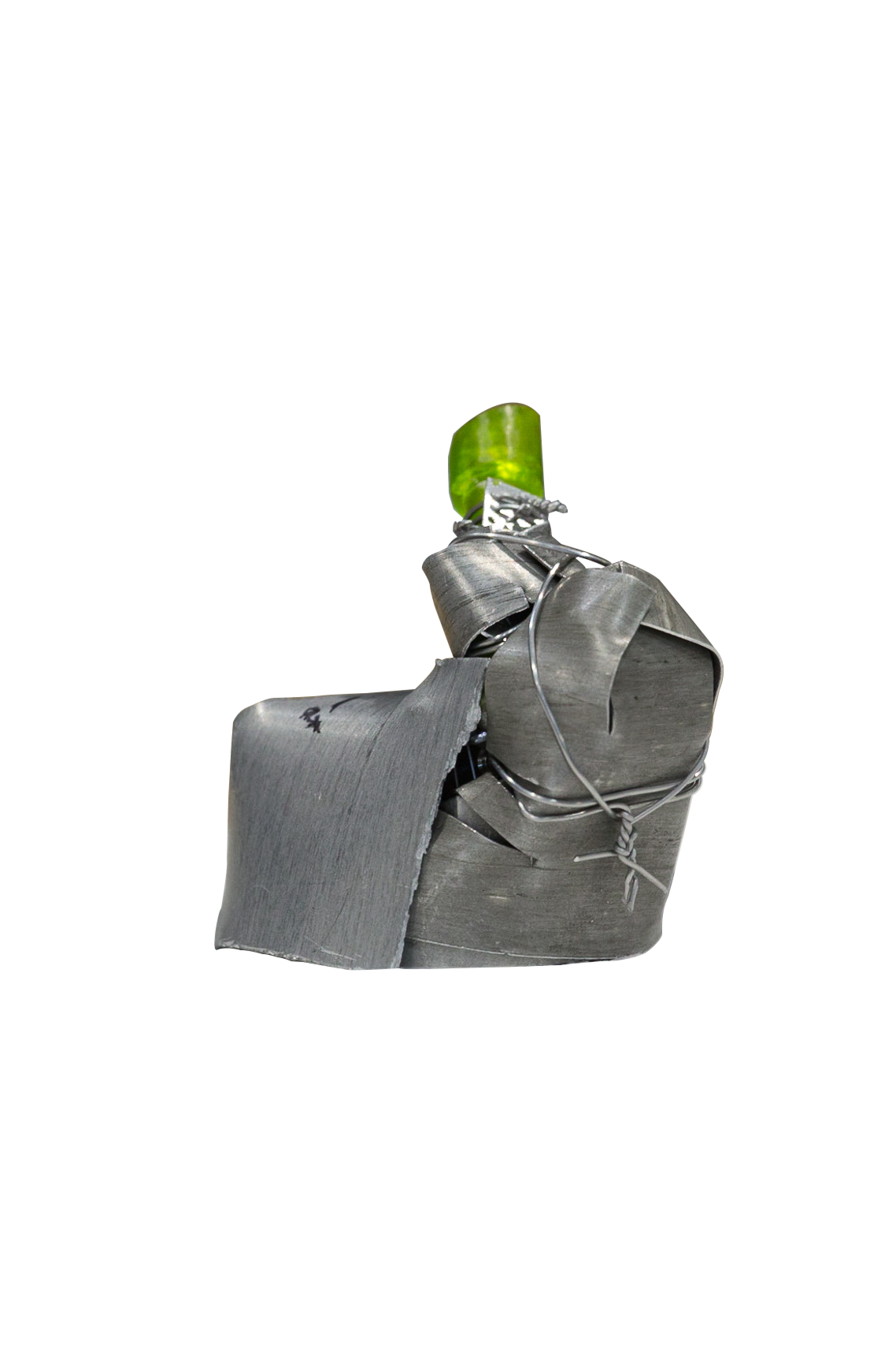
Building a sample
log(I)

Slide 13
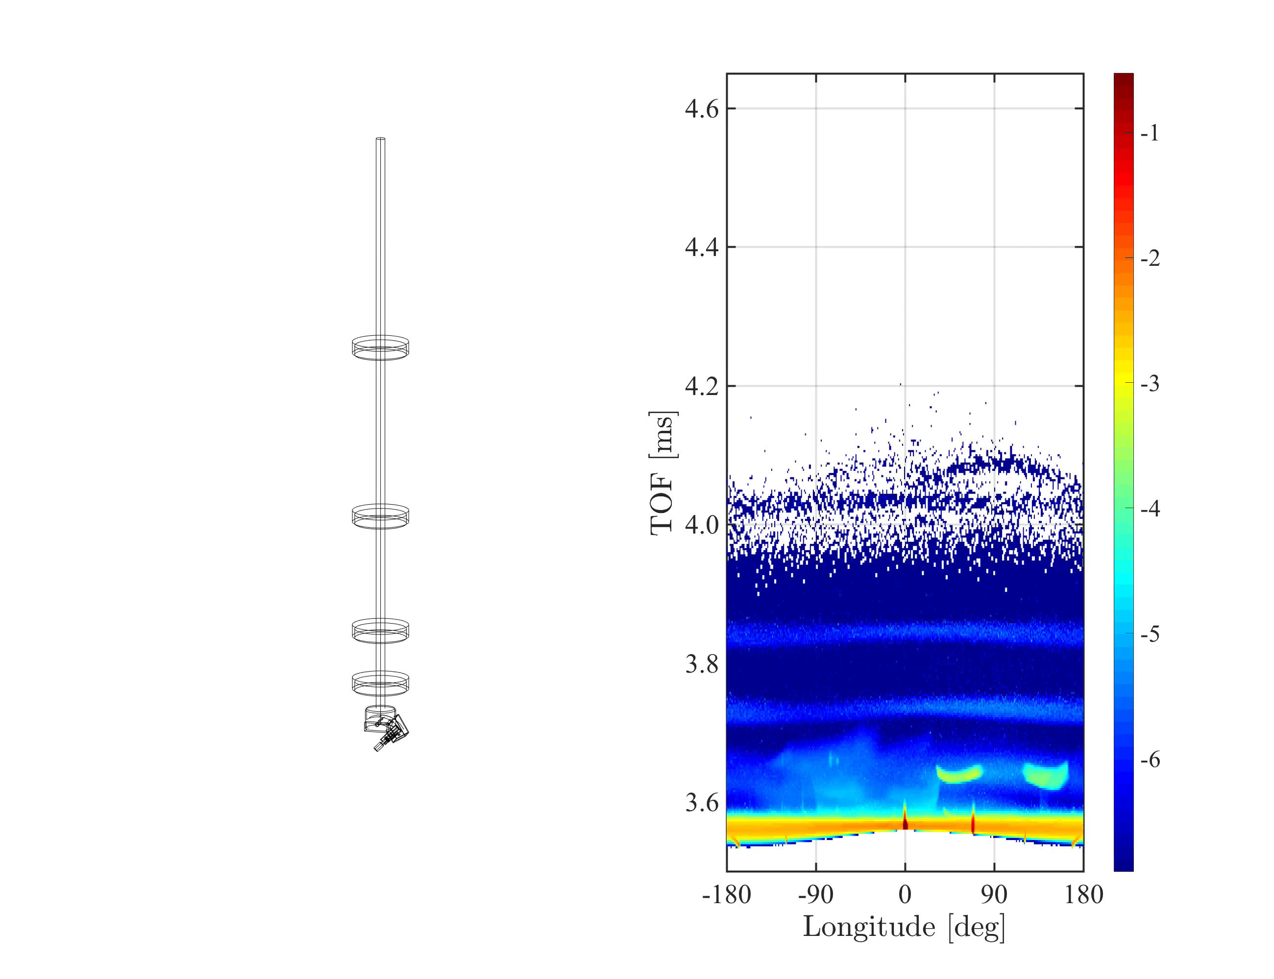
Building a sample
log(I)

Slide 14
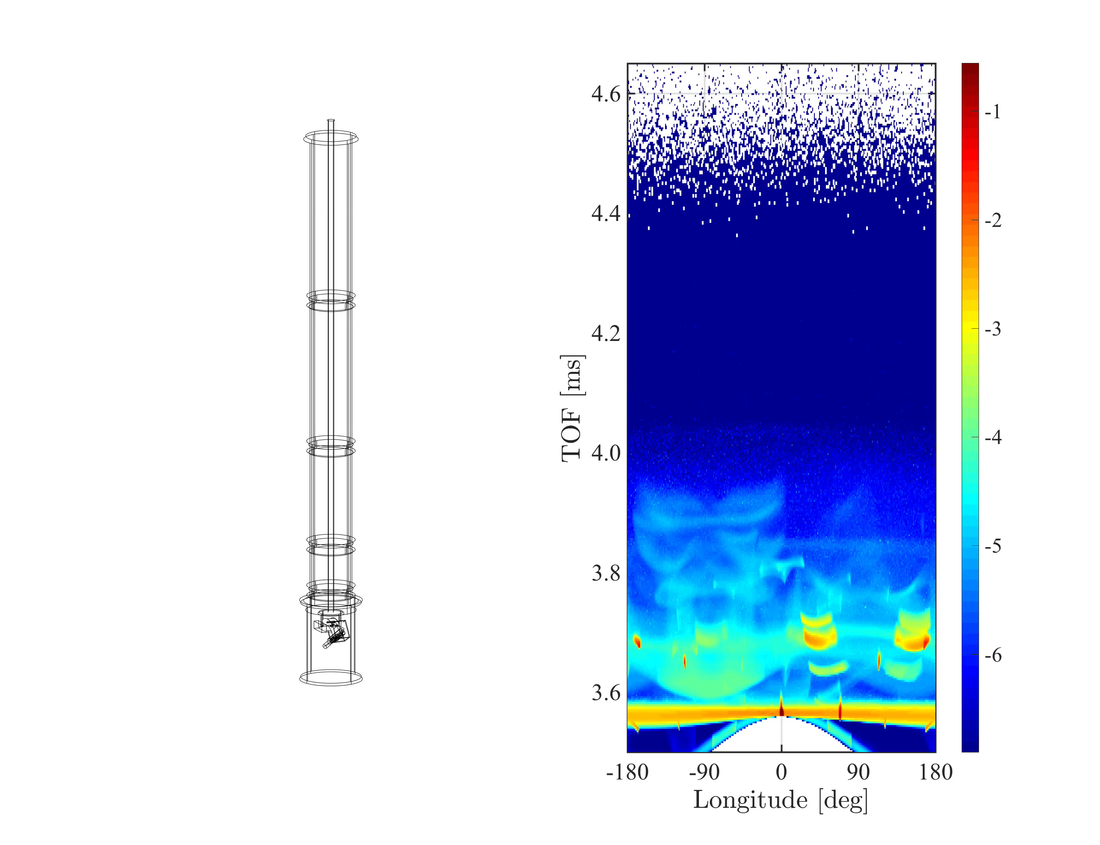
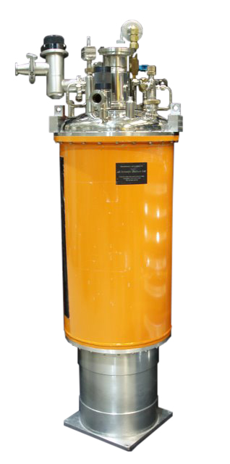
Building a sample
log(I)
Image from NIST webpage

Slide 15
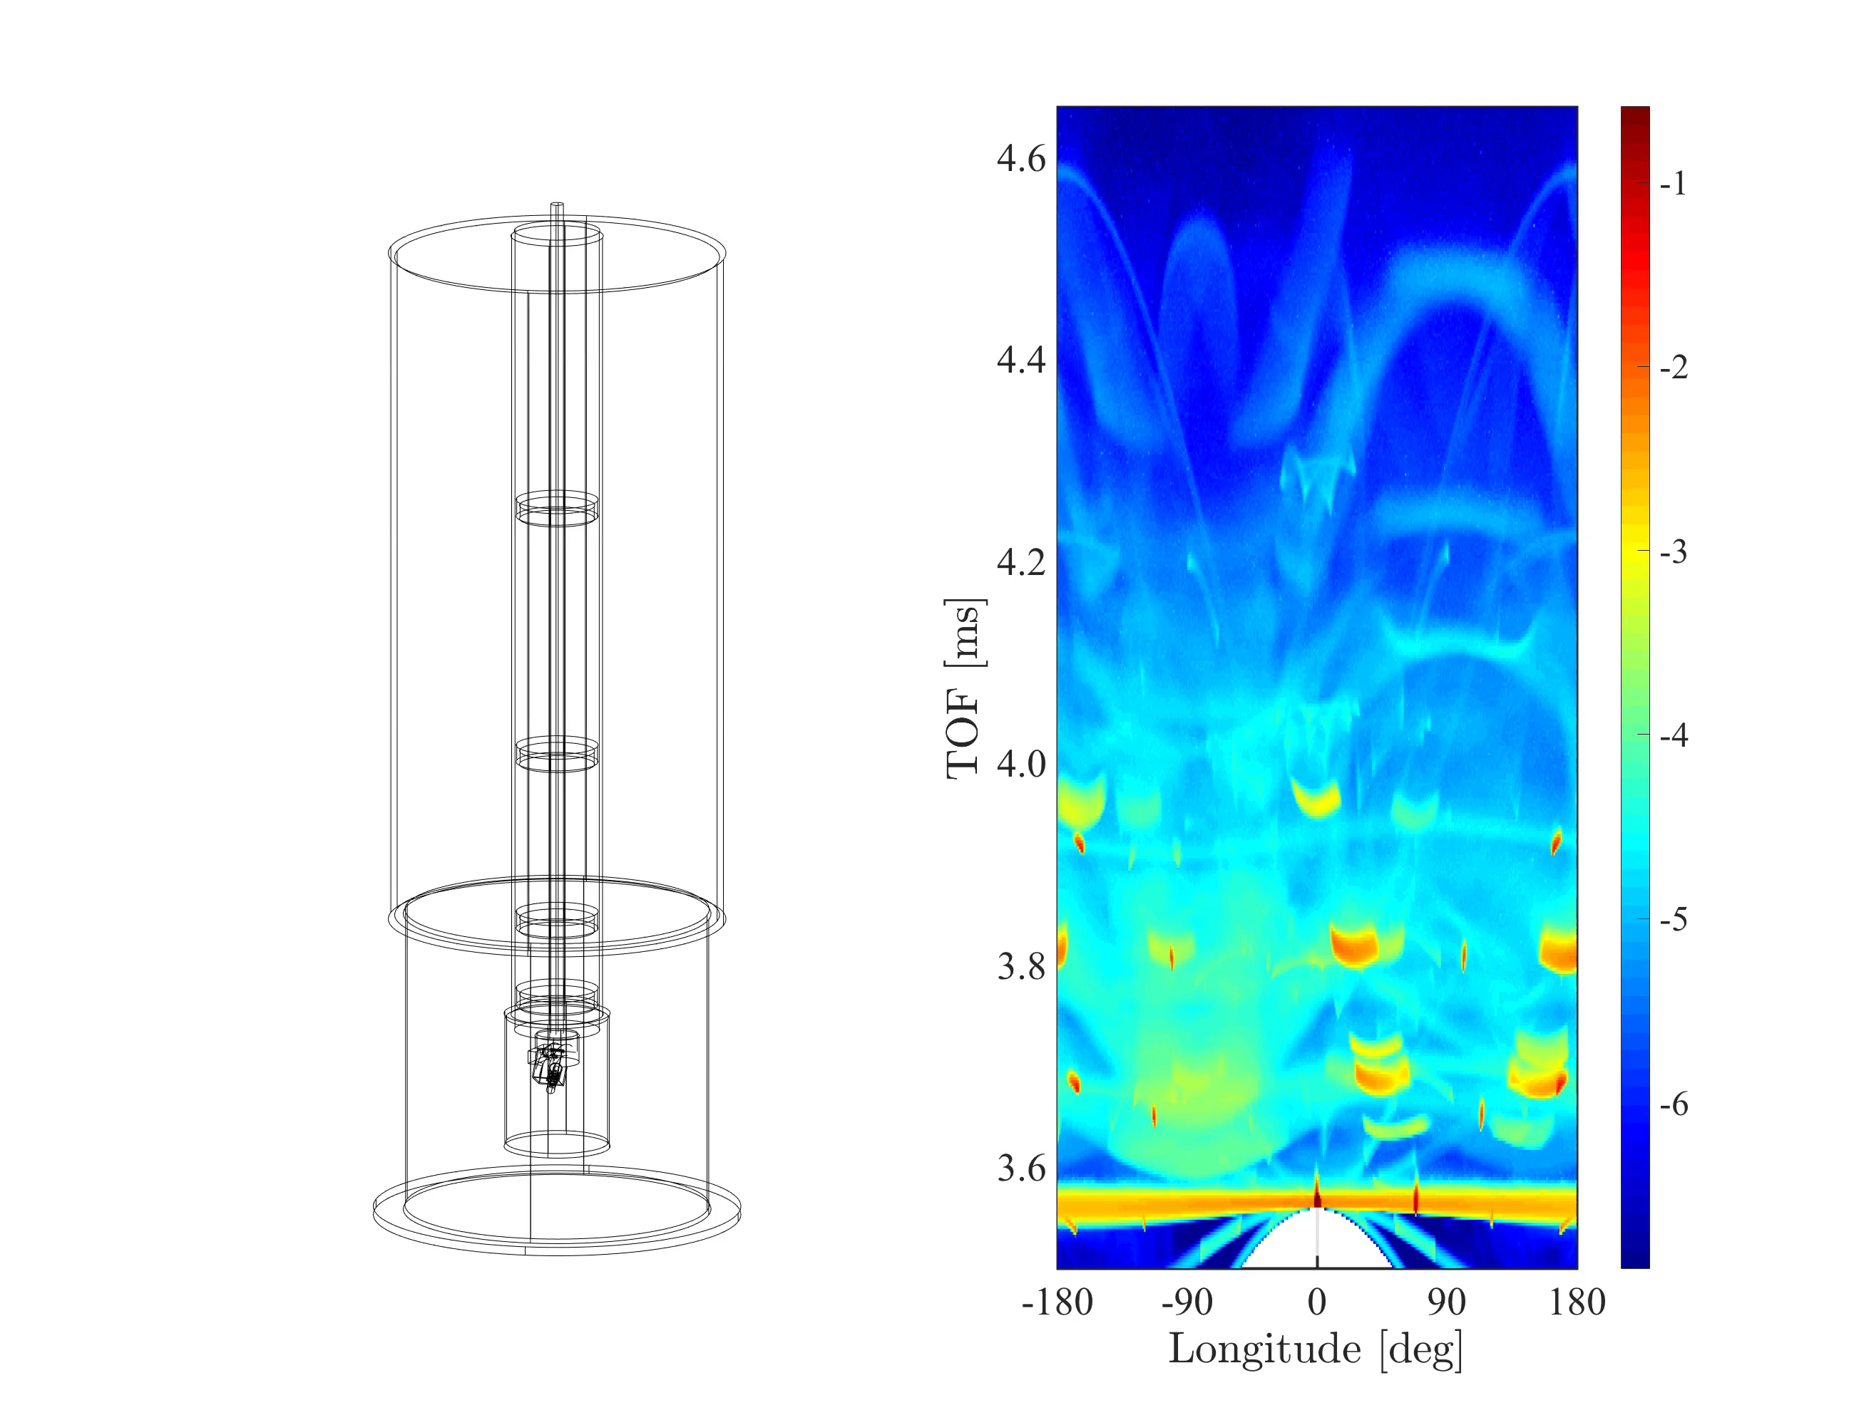
Building a sample
log(I)
Image from NIST webpage

Slide 16

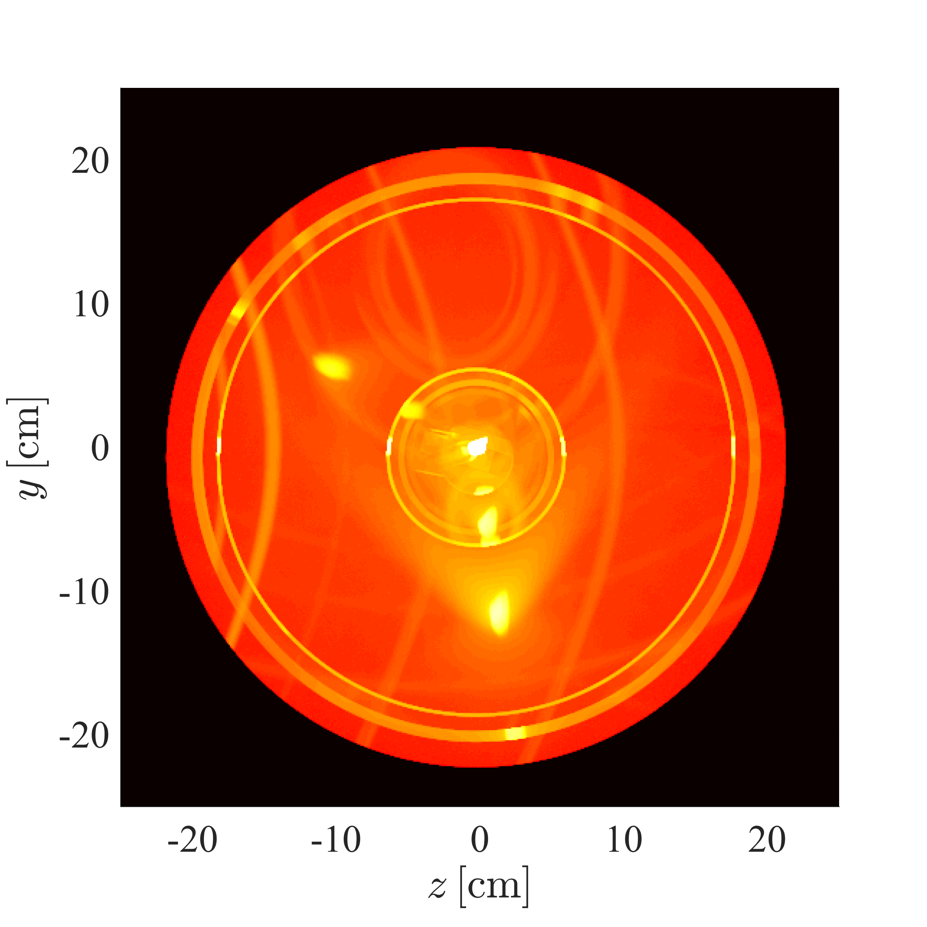
Building a sample
log(I)
log(I)
Image from NIST webpage

Slide 17
Union loggers
Record information during scattering
Here spatial distribution of scattered intensity from above
COMPONENT scattering_zx = Union_logger_2D_space( D_direction_1="z",D1_min=-0.25,D1_max=0.25,n1=300, D_direction_2="x",D2_min=-0.25,D2_max=0.25,n2=300, filename="scattering_zx.dat") AT (0,0,0) RELATIVE sample_position

Slide 18
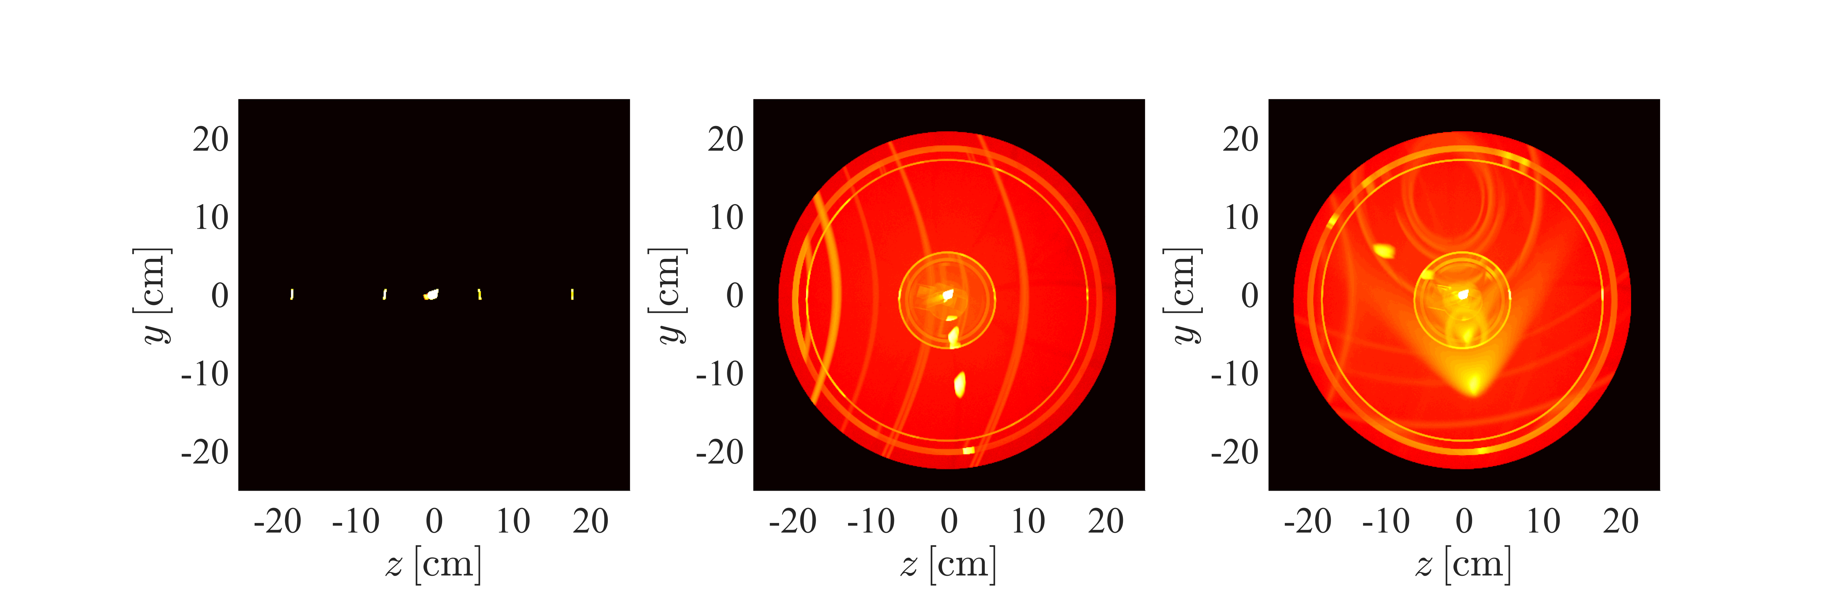
Union loggers
All
Can select to view just a specifc order of scattering in the system
COMPONENT scattering_zx_1 = Union_logger_2D_space( D_direction_1="z",D1_min=-0.25,D1_max=0.25,n1=300, D_direction_2="x",D2_min=-0.25,D2_max=0.25,n2=300, filename="scattering_zx.dat”,order_total=1) AT (0,0,0) RELATIVE sample_position
1
2
3

Slide 19
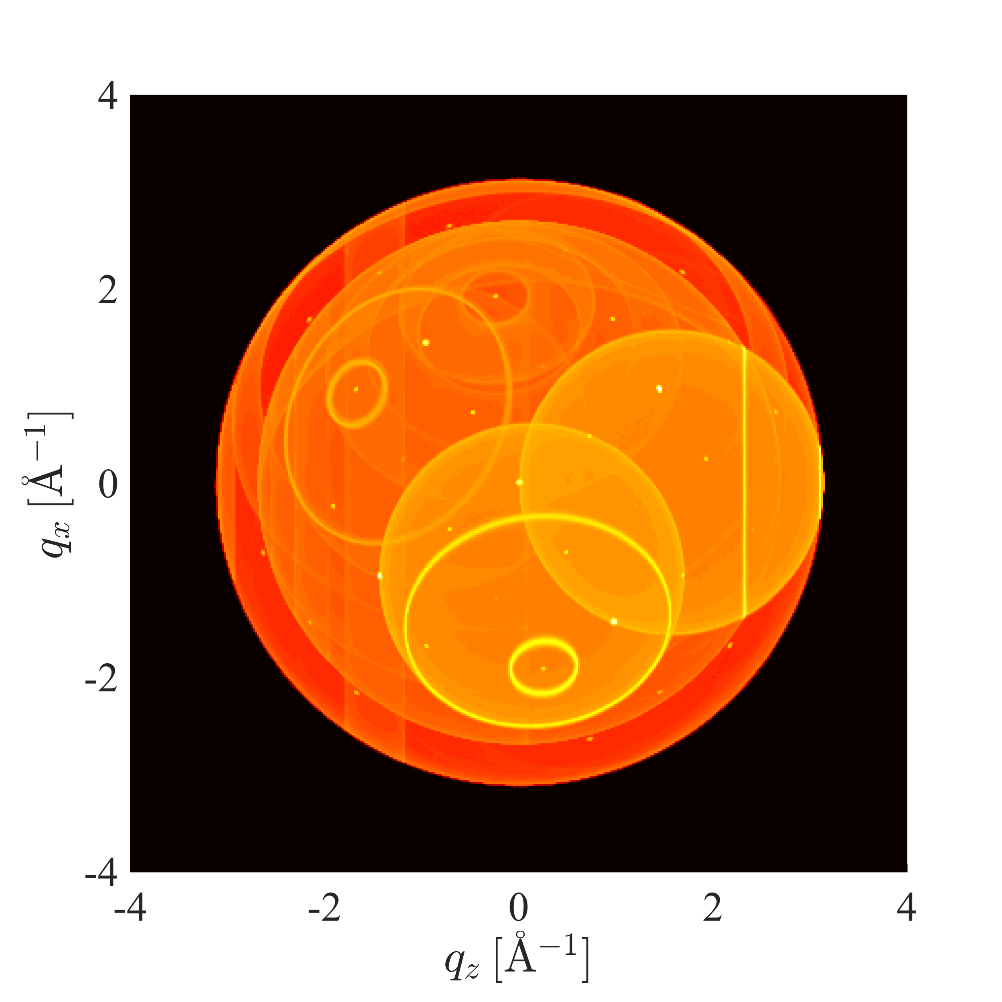
Union loggers
Here the scattering vector is recorded
COMPONENT scattering_zx_Q = Union_logger_2DQ( Q_direction_1="z",Q1_min=-4,Q1_max=4,n1=300, Q_direction_2="x",Q2_min=-4,Q2_max=4,n2=300, filename="scattering_zx_Q.dat") AT (0,0,0) RELATIVE sample_position

Slide 20
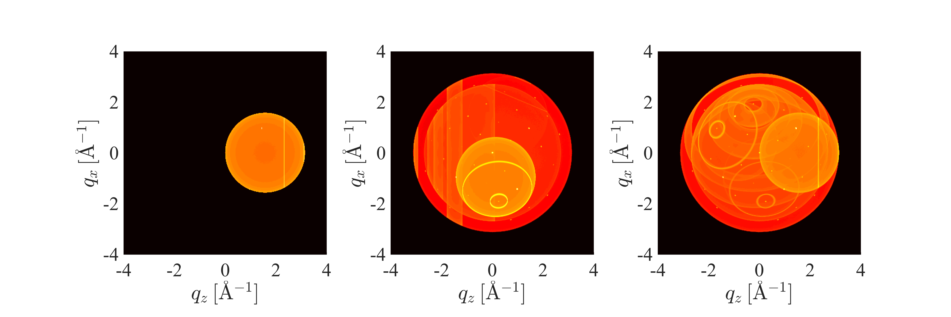
Union loggers
All
Can select to view just a specifc order of scattering in the system
1
2
3

Slide 21
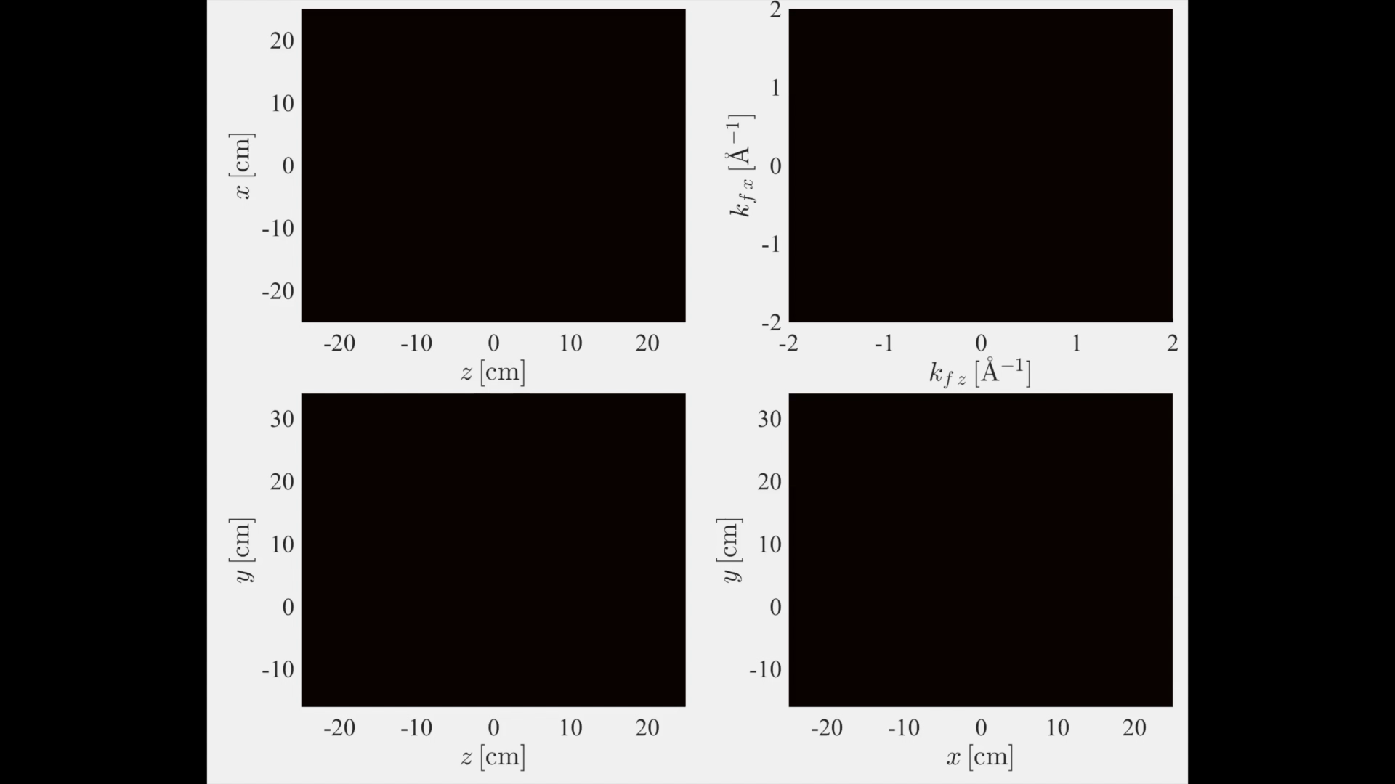

Slide 22
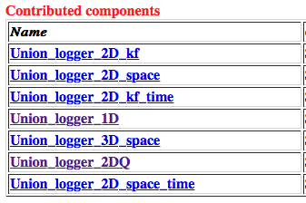
Union loggers – Use mcdoc

Slide 23

Union conditionals
log(I)
Wish to understand how individual background features arose

Slide 24
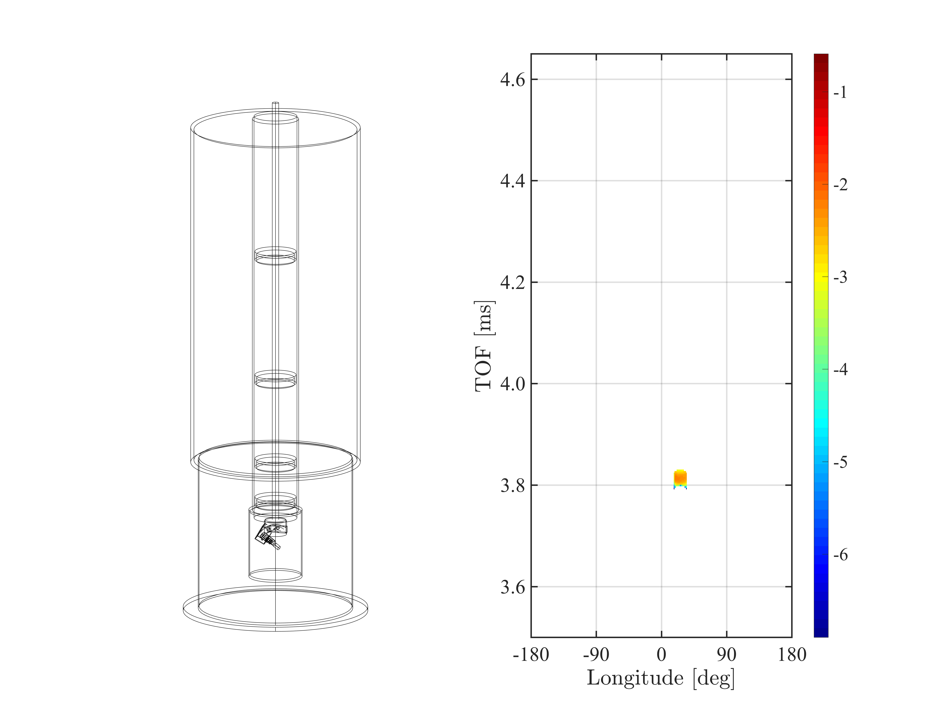
Union conditionals
log(I)
Wish to understand how individual background features arose
Select subset of output to be recorded in loggers using Union conditionals

Slide 25
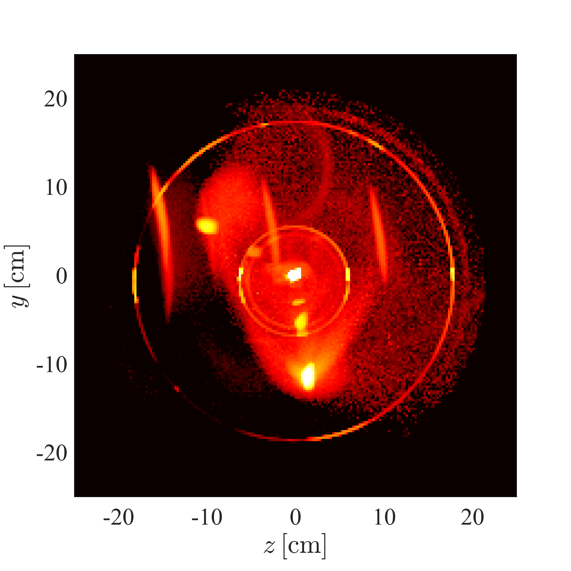
Union conditionals
Can limit the events that are recorded to the logger using conditionals
Here only rays that contribute to the chosen background problem is seen
Spatial distribution of scattered intensity
They modify an existing Logger
COMPONENT conditional = Union_conditional_PSD( target_loggers=” scattering_zx”, xwidth=0.01,yheight=0.01 time_min=1.2E-3, time_max=1.5E-3) AT (0,0,1) RELATIVE sample_position

Slide 26
Union conditionals
COMPONENT scattering_zx = Union_logger_2D_space( D_direction_1="z",D1_min=-0.25,D1_max=0.25,n1=300, D_direction_2="x",D2_min=-0.25,D2_max=0.25,n2=300, filename="scattering_zx.dat") AT (0,0,0) RELATIVE sample_position
COMPONENT conditional = Union_conditional_PSD( target_loggers=” scattering_zx”, xwidth=0.01,yheight=0.01 time_min=1.2E-3, time_max=1.5E-3) AT (0,0,1) RELATIVE sample_position

Slide 27
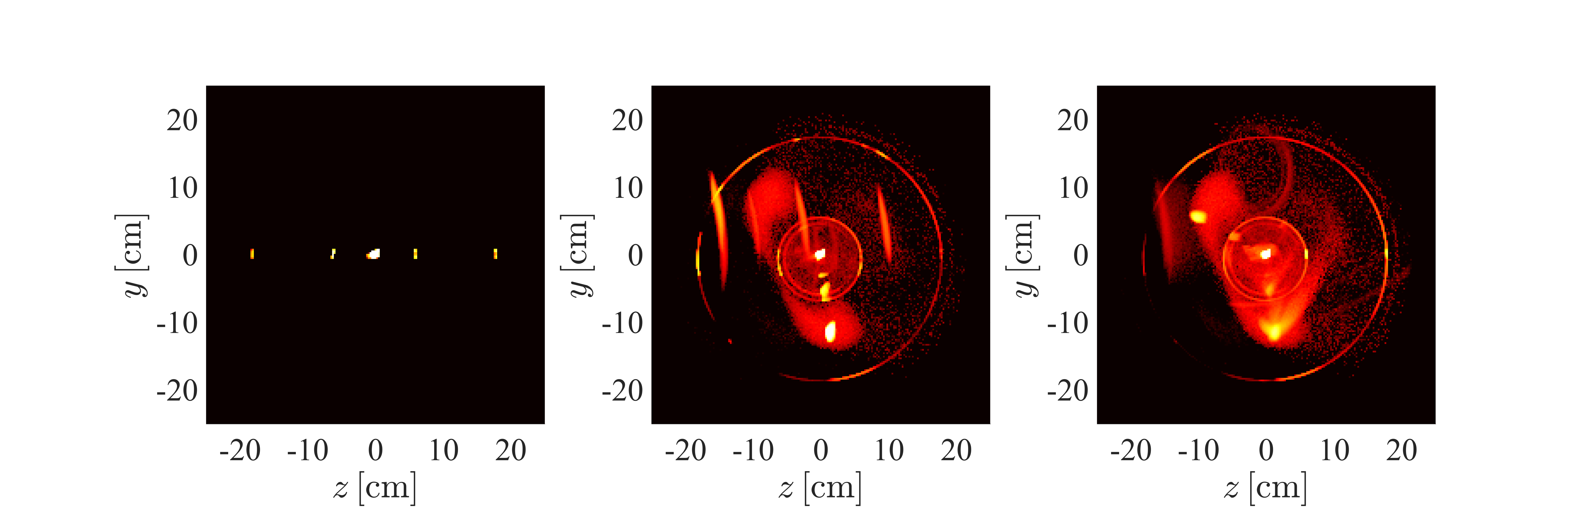
Union conditionals
All
The different scattering orders makes it easier to draw conclusions
1
2
3

Slide 28
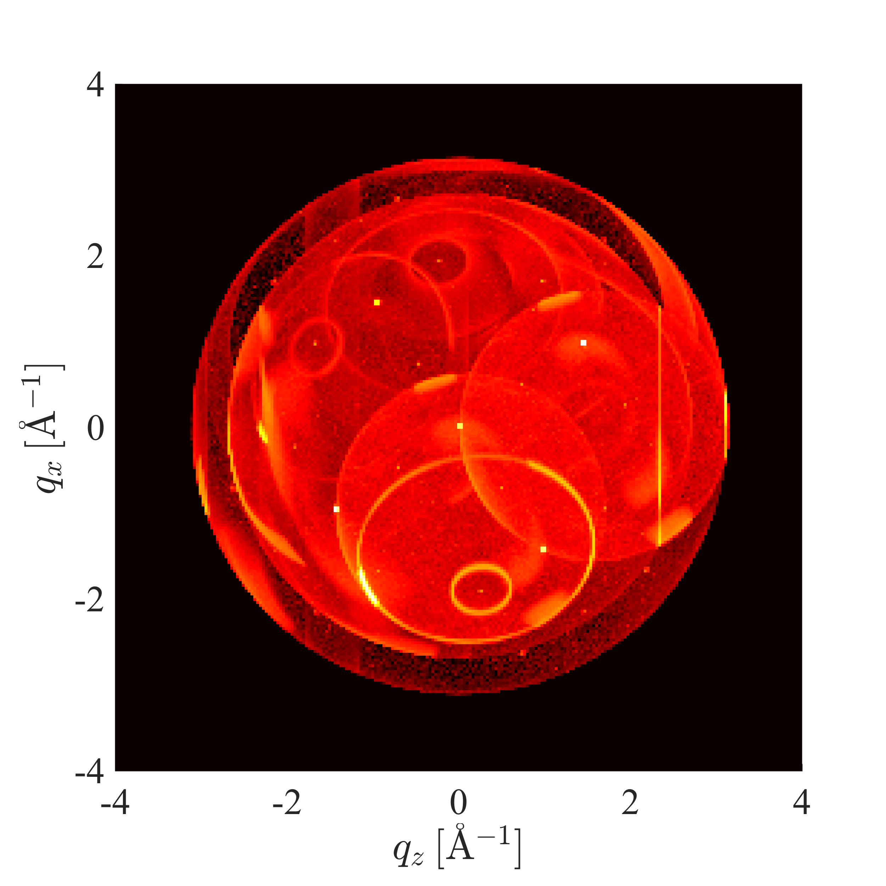
Union conditionals
Scattering vectors of rays that contribute to the chosen background problem

Slide 29
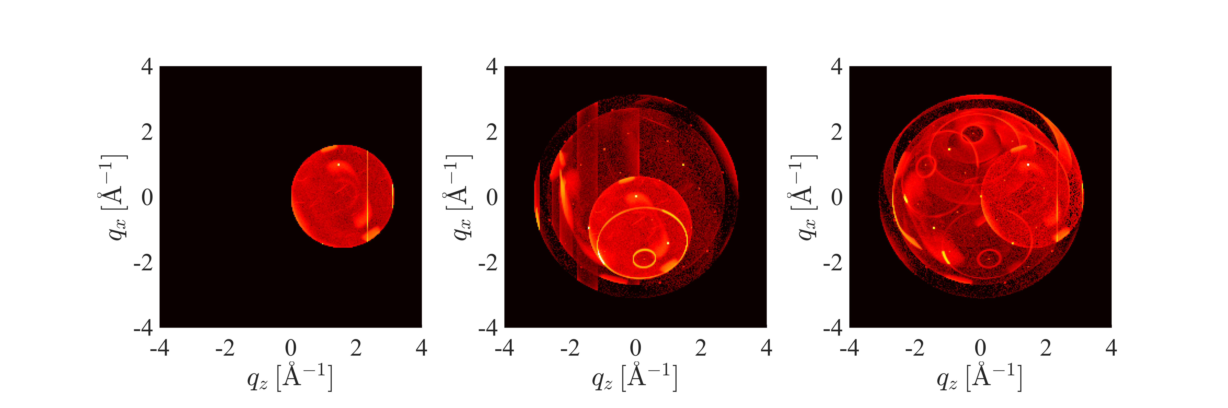
Union conditionals
All
Easier to see scattering orders
1
2
3

Slide 31
Conclusion
Use Union components for complex geomtries or for modular physics
Performs full multiple scattering simulation
Slower than typical McStas simulations, but still runs well on a laptop
Strong visualization tools
Easier to contribute physics

Slide 32
Exercise
Add loggers to your instrument file from the last session
A solution file is available on github for inspiration
mcdoc Union_logger
Mcdoc Union_conditional
One last demonstration talk after the exercise

